Slide 1
Substitution Manager
Caleb Burns
CIS152 – Data Structures
Dec 5, 2024

Slide 2
The Real-World Problem
Youth athletes should all get the same amount of playing time.
It is difficult for coaches to track and manage how long each child is on the court.
An application that tracks this for the coach would be useful for the coach and the athletes.
In youth sports, it is important each kid gets equal amounts of playing time compared to the others on their team. This way it is fair to all, and each kid is given the same chances and opportunities to succeed as the other kids. However, as a coach this could be challenging managing how long each player has played and who hasn't played enough. Coaches want a solution that can solve this very problem. Substitution Manager can help these coaches of elementary basketball create a fair environment for the kids.

Slide 3
How My Program Helps
A Roster class full of Player classes that hold info like minutes.
A Court class that uses a linked list and Bench class that uses a sorted queue will work together to track who is playing and who is not.
Substitution Manager has functionality to allow substitutions at any point in the game and will accurately track player minutes.
Substitution Manager allows the coach to create a roster with all the kids and save it for later use. The application uses a linked list to store the players on the court and a queue to store the players on the bench. The queue for bench players is then sorted based on who has the least amount of minutes. The coach can enter the time on the scoreboard and make substitutions while the application tracks the minutes.

Slide 4
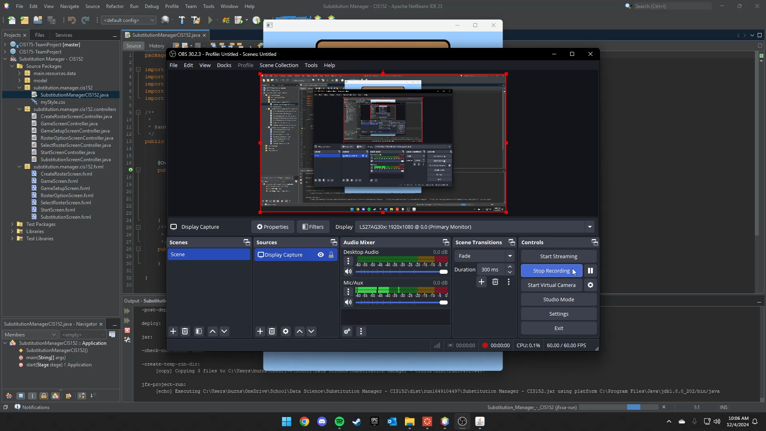
Demonstration Video
GitHub - https://github.com/BurnsCaleb/Substitution-Manager---CIS152

